Slide 1
Persecution as Crime Against Humanity in the Context of the Nagorno-Karabakh Conflict
Dr. Gurgen Petrossian, LL.M.
Glendale
18.05.2024

Slide 2
Agenda
Introduction and Historical overview
The crime of persecution in the Rome Statute
The crime of persecution against Armenians
Possible proceedings before the ICC
Concluding remarks

Slide 3
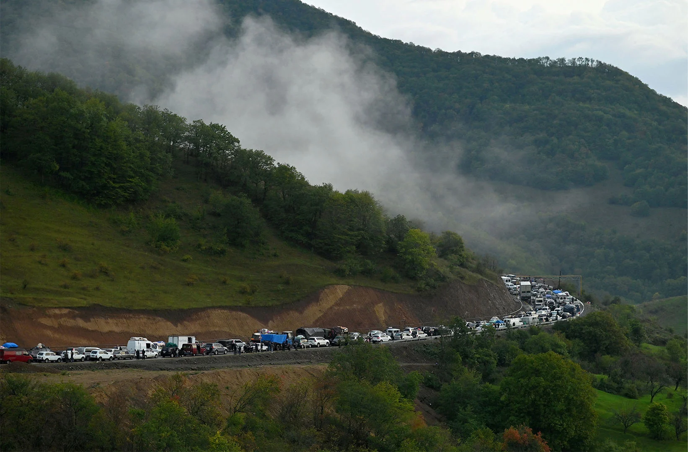
September 2023

Slide 4
I. Introduction
Armenia and the ICC
Crimes within the jurisdiction
1. War crimes committed on the territory of the Republic of Armenia since 2021
2. Crimes against Humanity committed against Armenians since 2021
Namely:
1. Deportation of Armenians from Nagorno Karabakh,
2. Persecution against Armenians by means of Deportation
3. Other Inhumane Acts against Armenians namely, preventing Armenians to return
Jurisdiction of the ICC
Armenia is full member of the ICC since 1 February 2024
The ICC has jurisdiction over the crimes committed since May 2021 on the territory of the Republic of Armenia
Territorial scope of Nagorno Karabakh remains outside of the jurisdiction
This means

Slide 5
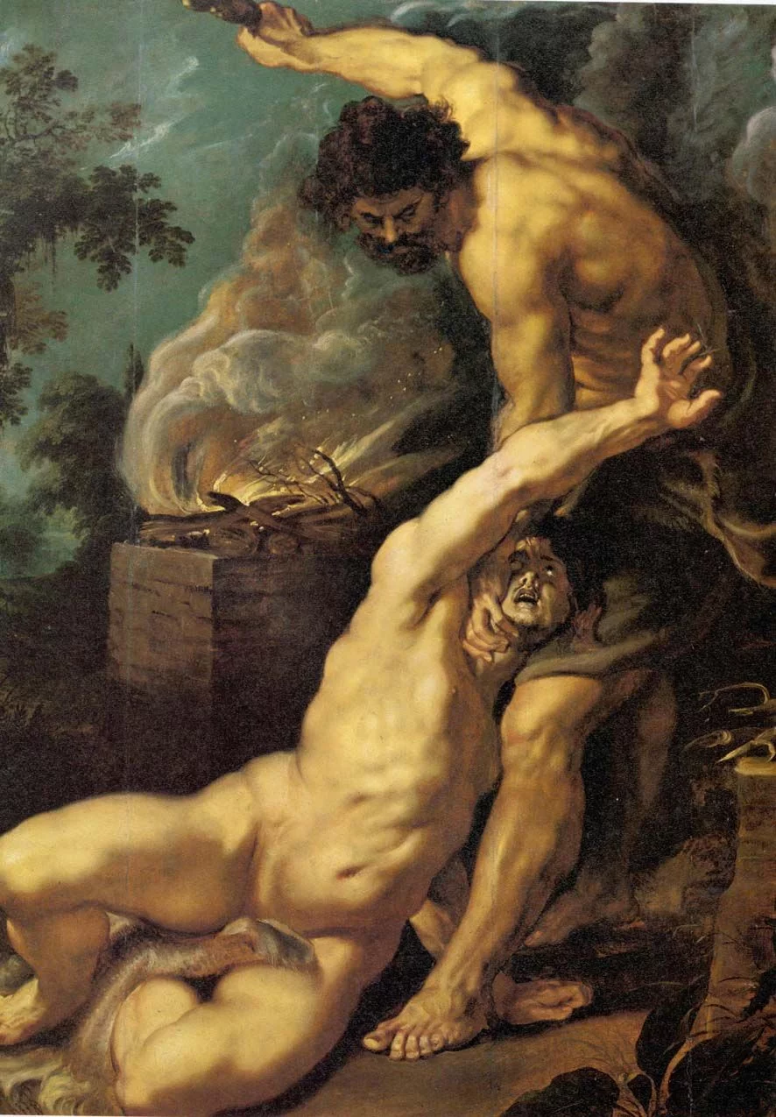



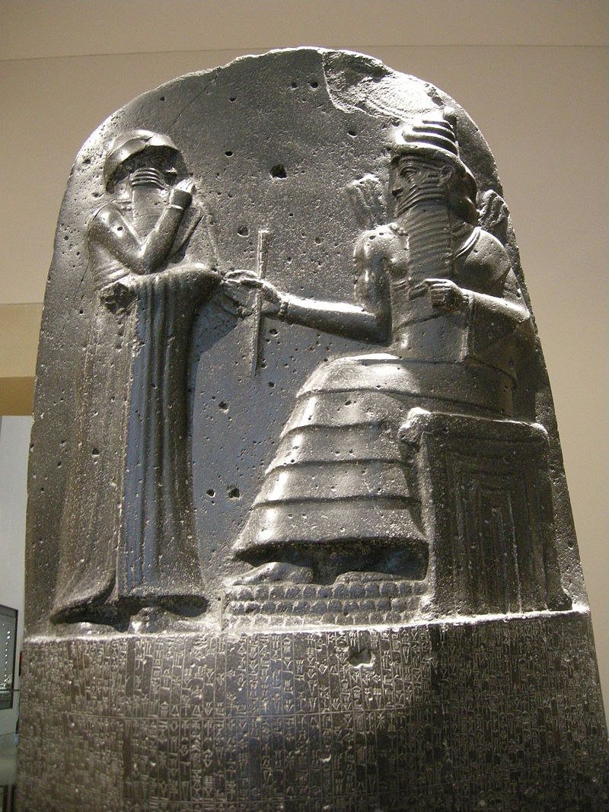
I. Historicial Overview (1/3)
Persecution in the history
Persecution of
Polytheistic priests in Egypt;
Jews in the Seleucid and Roman Empires as well as during the Middle Ages;
Christians in both the Roman and Persian Empires;
Pagans in Europe;
Muslims and Jews during the Crusades and Inquisitions.
Persecution was not always deemed criminal, but certain legal regulations emphasized equality and anti-discrimination.
Kain and Abel: Genesis 4:8 (NIV)
Laws 209 and 210 of the Code of Hammurabi:
“If a man strike a free-born woman so that she lose her unborn child, he shall pay ten shekels for her loss”.
“If the woman die, his daughter shall be put to death”.
7th Edict of Ashoka
“The beloved of the gods, king Piyadasi, desires that all religions should reside everywhere, for all of them desire self-control and purity of heart. (…)“
Magna Charta / Bill of Rights /
Code of Hammurabi

Slide 6
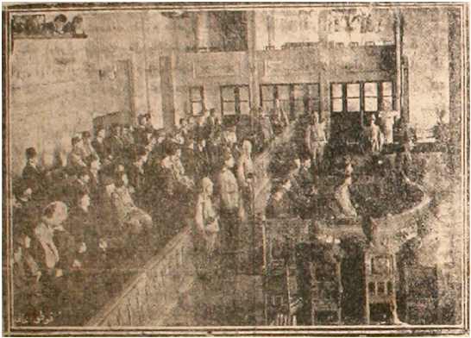
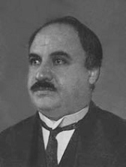
I. Historicial Overview (2/3)
Persecution in WWI
The Allied powers of the Entente denounced the atrocities inflicted upon the Armenian population by the Ottoman Empire in 1915 as:
CRIMES AGAINST HUMANITY AND CIVILIZATION
ISTANBUL TRIALS
Article 56 of the Imperial Ottoman Penal Code, which states:
“Whoever dares to make the people of Ottoman dominions arm themselves against each other, to instigate or incite them to engage in mutual slaughter, or to bring about acts of rapine, pillage, devastation of the country, or homicide in various places, is, if the disorder takes effect entirely or if a commencement of the disorder has been made, likewise put to death”. ≠ Persecution
The Imperial Ottoman Penal Code (1913).
Istanbul Trials
Pan-Turkism in Istanbul Trials 1919
“Azerbaijani Turks have already commenced efforts toward realizing Turan. The dissemination of the Turkish language and the embrace of Turkish literature would foster unity among all Turks"
Ziya Gökalp

Slide 7
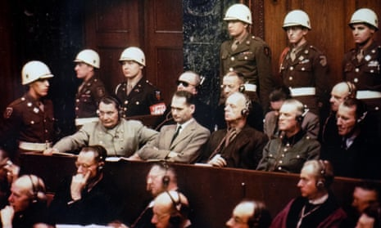
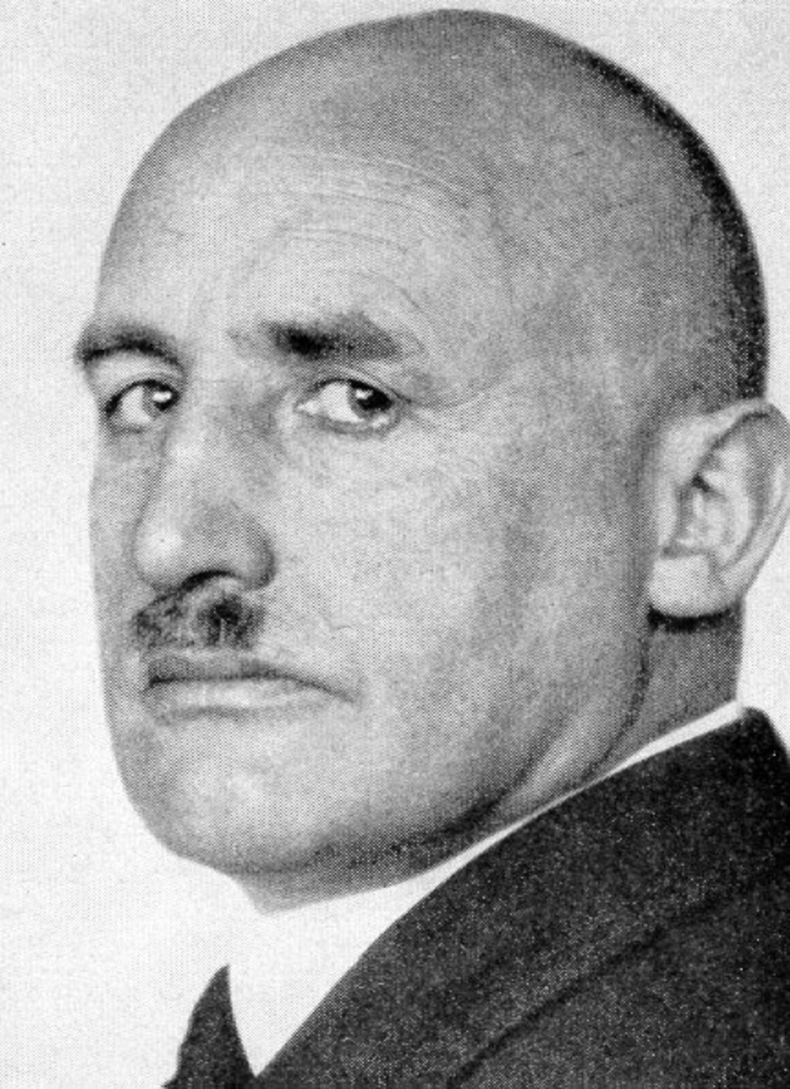
I. Historicial Overview (3/3)
Persecution in WWII
International Military Tribunal
Not a standalone crime
Article 6 (c) ' Crimes against humanity.- ' namely, murder, extermination, enslavement, deportation, and other inhumane acts committed against any civilian population, before or during the war, or persecutions on political, racial or religious grounds in execution of or in connection with any crime within the jurisdiction of the Tribunal, whether or not in violation of the domestic law of the country where perpetrated. London Charter
Nuremberg Trials
Julius Streicher
Such was the poison Streicher injected into the minds of thousands of Germans which caused them to follow the National Socialist policy of Jewish persecution and extermination Streicher's relentless incitement to murder and extermination
Julius Streicher

Slide 8
II. Crime of Persecution in the Rome Statute (1/3)
Level 4
Genocide
Genocide represents the most extreme and inhumane manifestation of persecution with special intent to destroy.
Level 3
Persecution
Persecution represents the most severe form of discrimination, involving systematic and targeted violations of individual rights based on certain characteristics
Level 2
Institutionalized Discrimination
discriminatory practices within the structures not necessarily targeting but, perpetuating inequalities and disadvantages for certain groups. (stems from long-standing norms)
Level 1
Discrimination
acts of prejudice or bias against individuals or groups based on certain characteristics

Slide 9
II. Crime of Persecution in the Rome Statute (2/3)
Rome Statute
Persecution as Crimes Against Humanity
Context
crime against humanity means any of the following acts when committed as part of a widespread or systematic attack directed against any civilian population, with knowledge of the attack:
Persecution
“Persecution” means the intentional and severe deprivation of fundamental rights contrary to international law by reason of the identity of the group or collectivity
Persecution against any identifiable group or collectivity on political, racial, national, ethnic, cultural, religious, gender as defined in paragraph 3, or other grounds that are universally recognized as impermissible under international law, in connection with any act referred to in this paragraph or any crime within the jurisdiction of the Court;

Slide 10
II. Crime of Persecution in the Rome Statute (3/3)
Elements of Crime
1. Severe deprivation of fundamental rights = Deportation
2. Targeting person or persons by reason of the identity = Group
3. Based on characteristic / Discriminatory Intent = Ethnicity/Religion
4. in connection with any act within the jurisdiction of the Court = Deportation
5. as part of a widespread or systematic attack directed against a civilian population
= Context
6. Knowledge of the perpetrator = mens rea

Slide 11
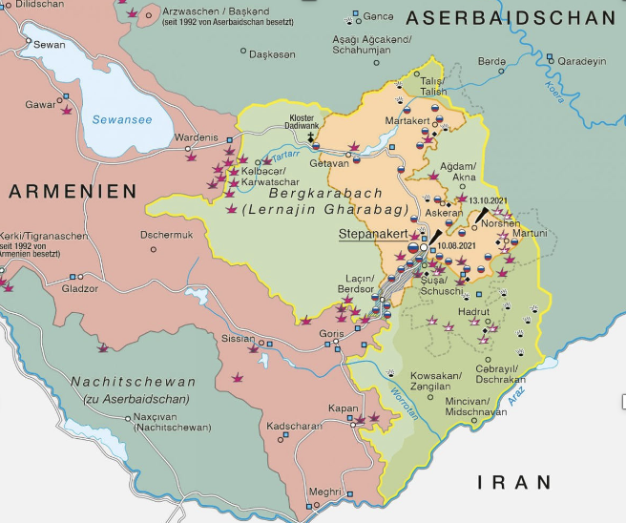

III. Persecution against Armenians 1/11
Jurisdiction at the ICC
ICC Jurisdiction = location, time and type of crime
Location = Deportation into Armenia (see Bangladesh/Myanmar)
Deportation is being “completed“ when the victims left the area where they were lawfully present = entered Armenia
Time = crime of deportation is ongoing crime
Deportation begins with coercive acts and is only consummated upon crossing an international border. Even after crossing the border, deportation may continue if the coercive acts prevent victims from returning (cf. Nahimana Appeal § 721).
Deportation
During 2020 War
Between December 2020 and September 2023
After September 2023
The question of jurisdiction primarily pertains to deportations occurring since May 2021. However, there remains uncertainty regarding whether victims deported before May 2021 might also come under jurisdiction.
2023
2020-2023
2020
ICC Jurisidction
2020
2021
2023

Slide 12
III. Persecution against Armenians 2/11
Deportation
Deportation
Deportation or forcible transfer of population means forced displacement of the persons concerned by expulsion or other coercive acts from the area in which they are lawfully present, without grounds permitted under international law.
The term "forcibly" extends beyond physical force and encompasses threats, coercion, fear of violence, duress, psychological oppression, or abuse of power against individuals, or exploitation of a coercive environment.
no genuine choice but to leave
Killings of the civilians who remained under control Azerbaijani forces.
Torture and mistreatment of civilians and prisoners of war.
Mutilation of bodies.
Sexual violence committed against Armenian women.
Acts of physical and psychological violence causing great suffering or serious injury to body or to mental or physical health, such as nine-month blockade of Nagorno-Karabakh and intentional starvation.
The policy of hatred towards Armenians, which includes the dissemination of video footages depicting violence against Armenians as described earlier.
Destruction of Armenian cultural heritage.
Destruction of property.
Impunity for those actions.
Persecution
These acts are not sporadic or isolated acts, but build part of the biggest picture of persecution

Slide 13
III. Persecution against Armenians 3/11
Persecution since Armenian Genocide
Narratives in Azerbaijan
Means of Persecution
Armenians are not indigenous to the Armenian Highlands
Changing the history
Hate speech
Taregting Armenian cultural heritage
Targeting Armenians generally without distinction between Armenians from Nagorno-Karabakh, from Armenia or from Diaspora
ECRI and CERD FINDINGS
2002; 2006; 2012, 2016; 2022; 2023
Armenians
Distinct ethnic group with ancient culture and history, own language and alphabet, own religion
The region did not belong to historical Armenia but was instead a part of Caucasian Albania
Armenians were viewed as significant impediments to achieving the objectives of Pan-Turkism

Slide 14

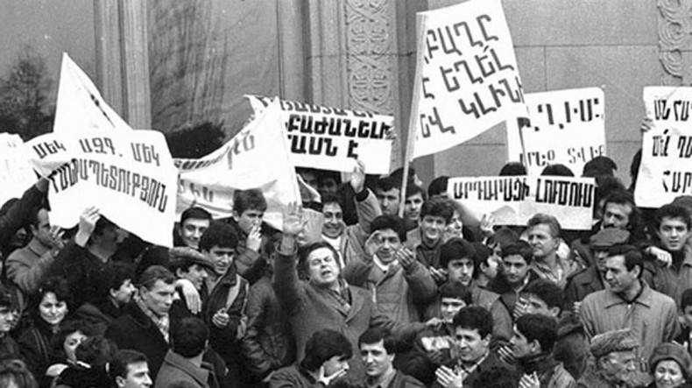
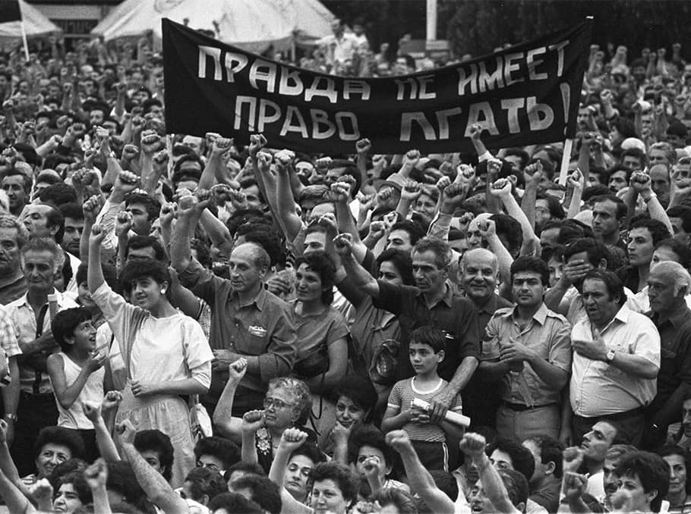
III. Persecution against Armenians 4/11
Persecution since Armenian Genocide
Soviet decree establishing the Nagorno-Karabakh Autonomous Region (NKAO) as part of Azerbaijani SSR
7 July 1923
NKAO Armenian attempts to reach Moscow to change the administrative borders between two SSRs
1950s
1960s
1970s
1980s

Slide 15
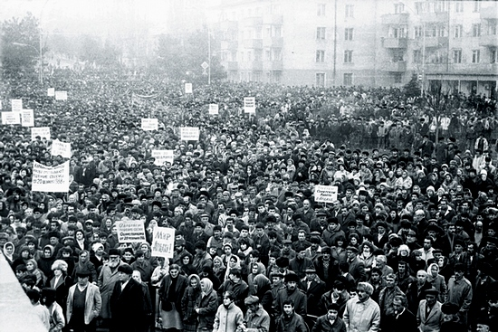


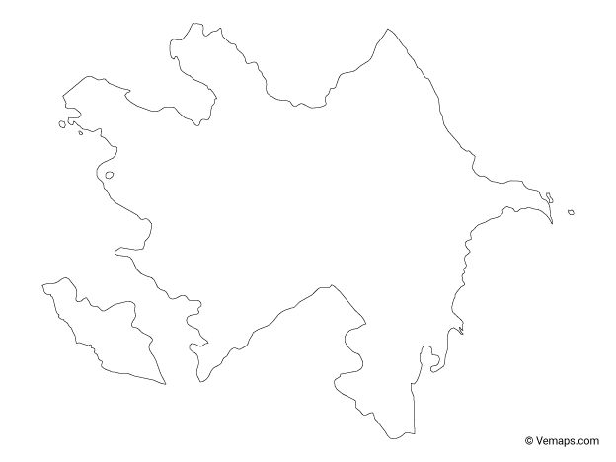
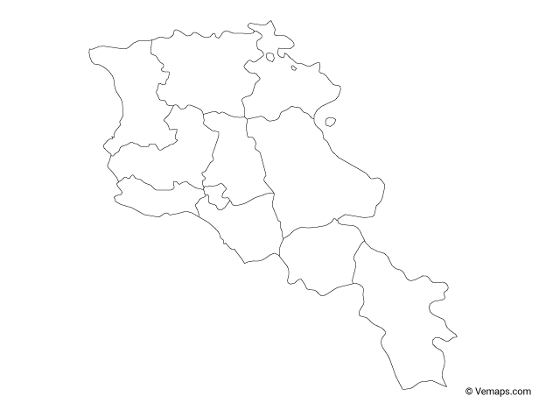
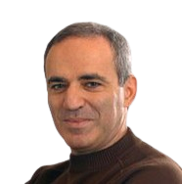
III. Persecution against Armenians 5/11
Kharabakh Movement - 1988
Armemian SSR
Azerbaijan SSR
Sumgait Progrom
Kirovabad Pogrom
Anti-Armenian Pogroms
Garry Kasparov
Demostrations Yerevan
Demostrations Stepanakert
Baku Pogroms

Slide 16


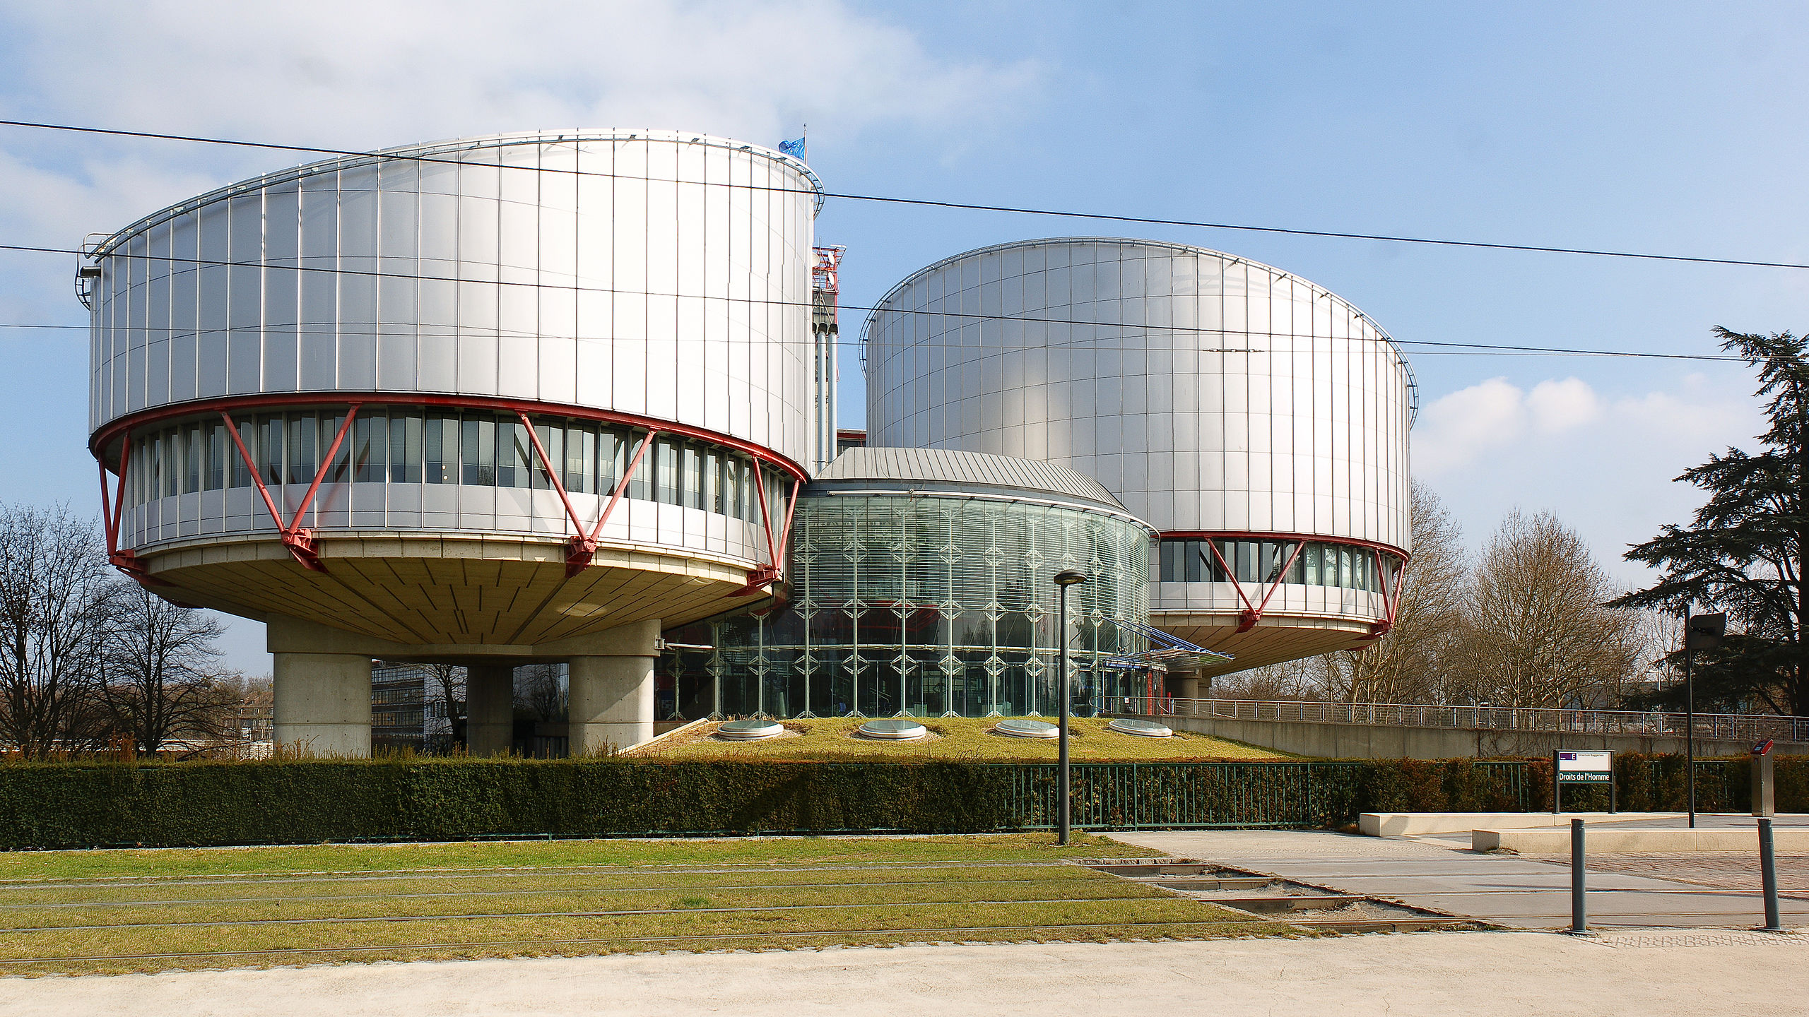
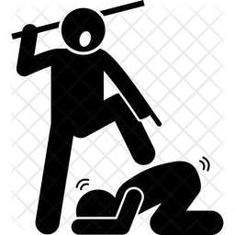
III. Persecution against Armenians 6/11
Judgments from ECtHR
1. Sargsyan v. Azerbaijan, 40167/06 from 2015 – Protection of property Article 1 I Protocol ECHR
2. Makuchyan, Minasyan v. Hungary and Azerbaijan, 17247/13 from 2020 – Right to life, Prohibition of discrimination Article 2 and 14 ECHR
3. Saribekyan, Balyan v. Azerbaijan, 35746/11 from 2020 – Right to life Article 2 ECHR
4. Badalyan v. Azerbaijan, 51295/11 from 2021 – Prohibition of torture Article 3 ECHR
5. Petrosyan v. Azerbaijan 32427/16 from 2021 – Right to life, Prohibition of torture, Article 2 and 3 ECHR

Slide 17
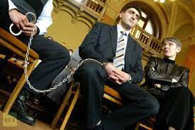
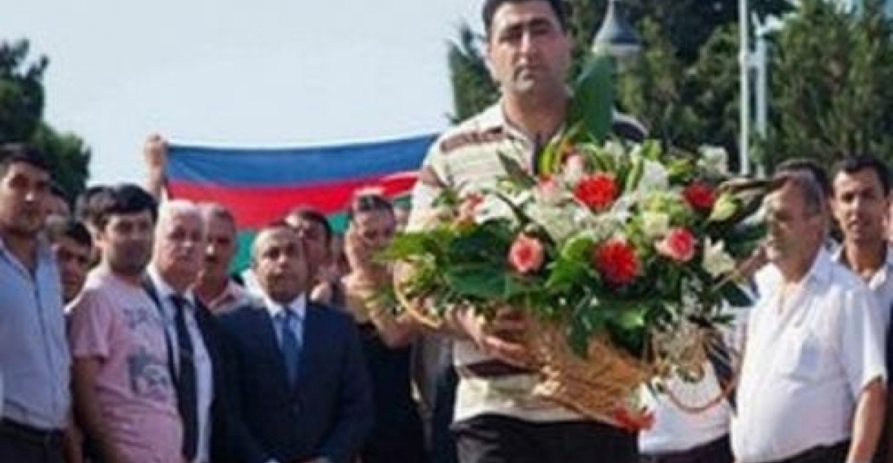
III. Persecution against Armenians 7/11
Widespread hate against Armenians
Makuchyan, Minasyan v. Azerbaijan
Ramil Safarov
The Court observes(…) R.S. was pardoned immediately upon his return to Azerbaijan; there is nothing in the case file to indicate that a formal request to that end was ever made, and nor is there any indication that there ensued any kind of reflection process or legal procedure for the pardon. (…) R.S. was not only reinstated in his post in the military, he was also promoted in military rank in a public ceremony shortly after his return to Azerbaijan. Moreover, he received a flat in Baku, together with salary arrears in respect of the entire period that he had spent in prison. (…), the Government have not indicated a domestic legal basis for any of those additional measures, which were understandably perceived as constituting rewards for R.S.’s actions.
The Court finds particularly disturbing the statements made by a number of Azerbaijani officials glorifying R.S. (see §§ 213 - 221).

Slide 18
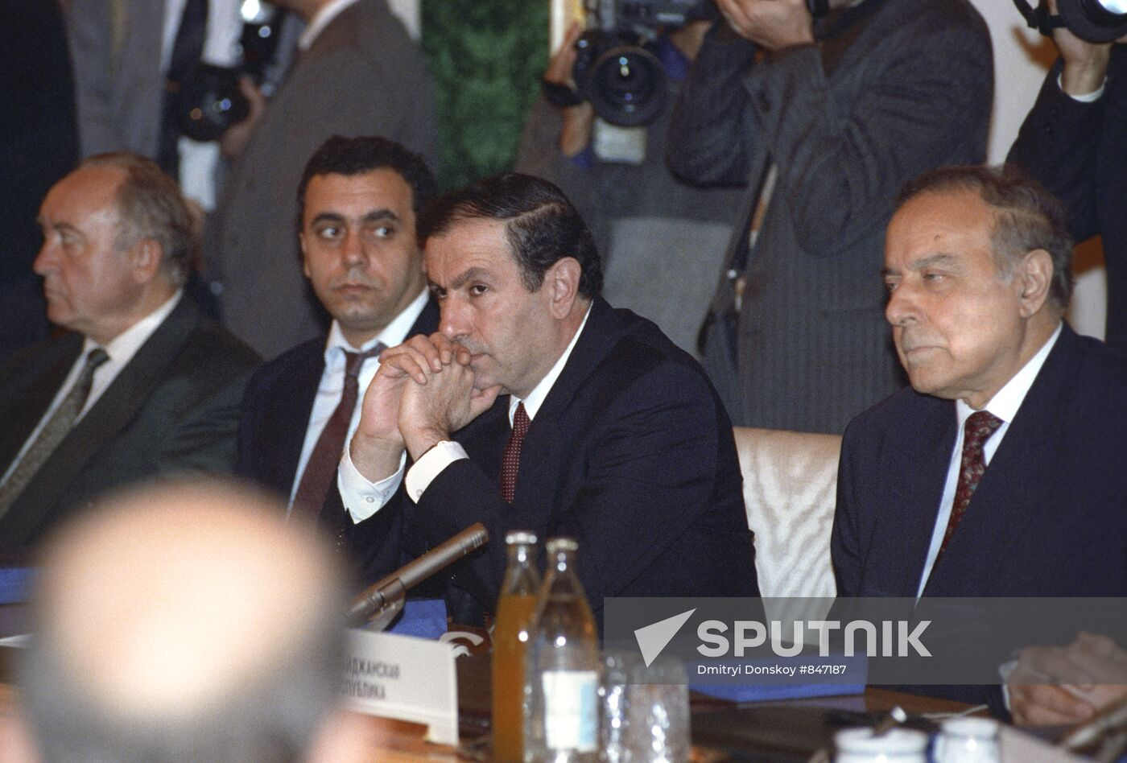
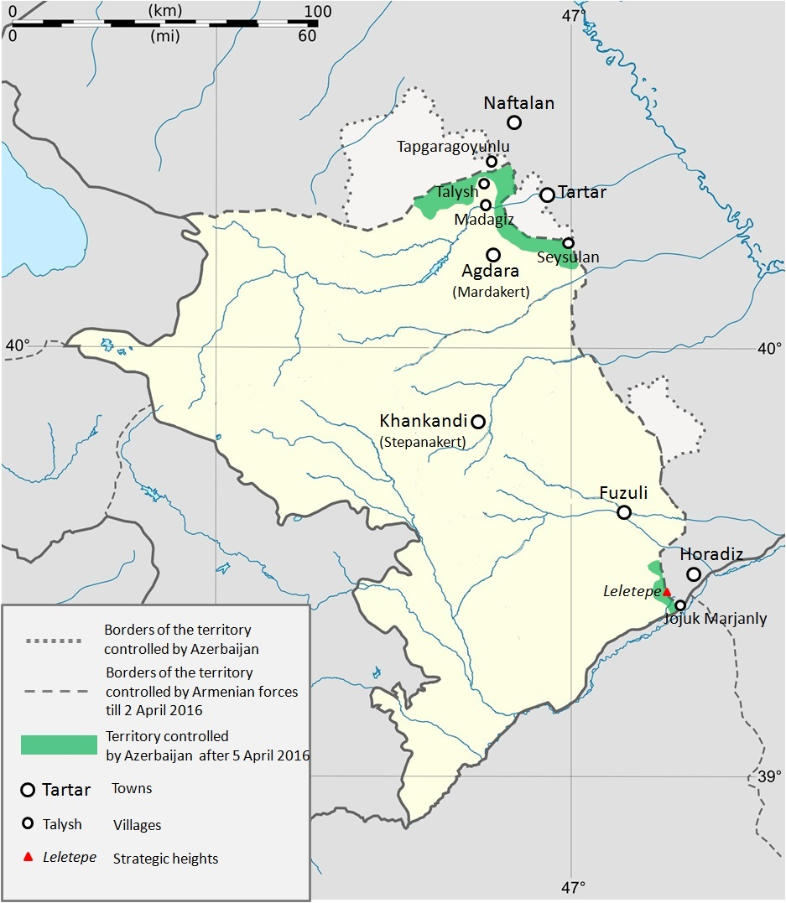
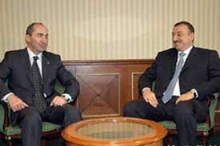
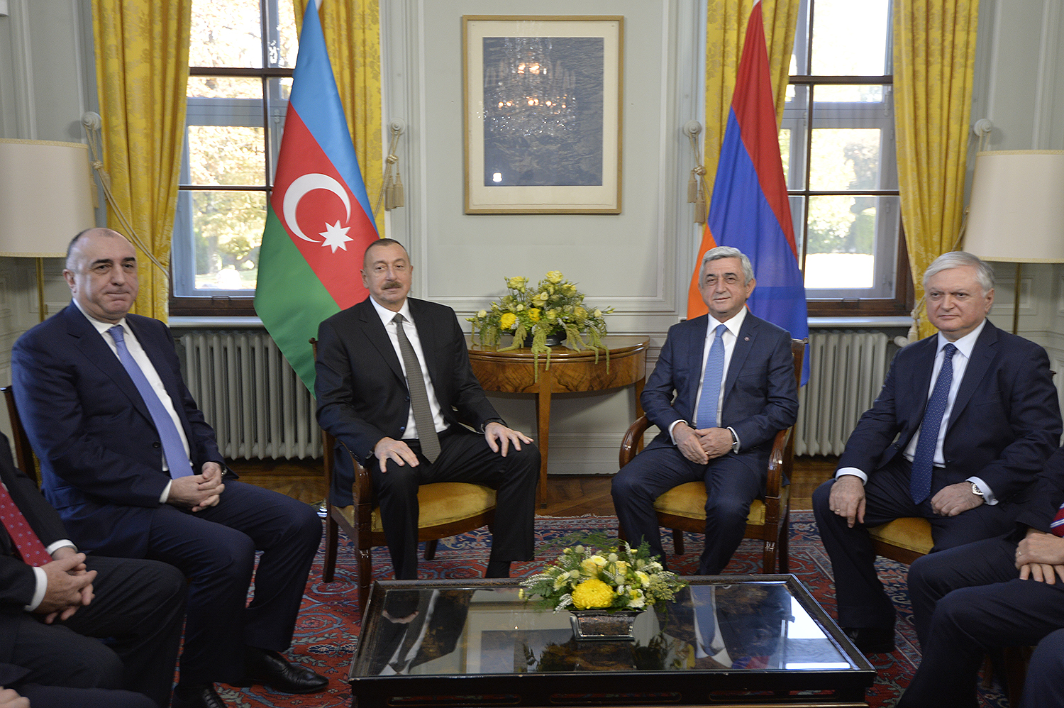
III. Persecution against Armenians 7/11
Escalation around Nagorno-Karabakh 2016
First war crimes including beheadings !

Slide 19
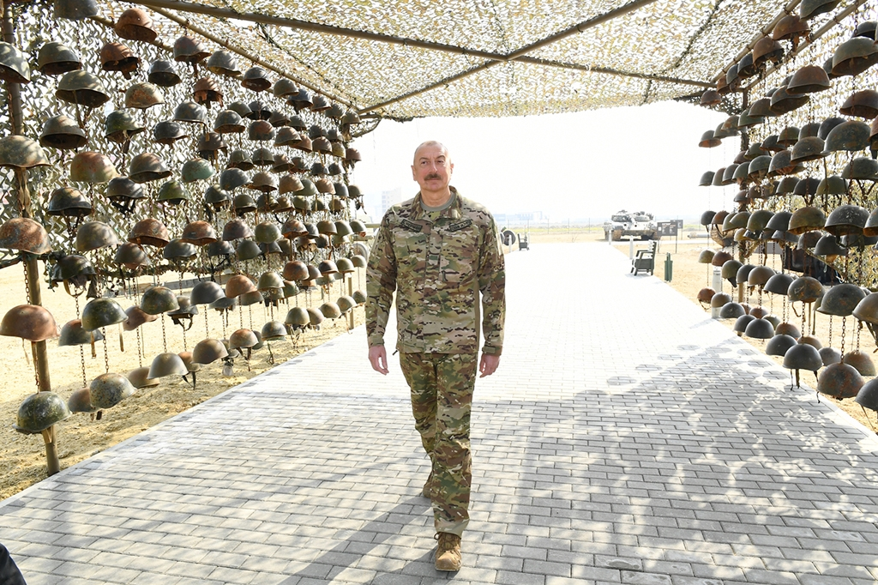
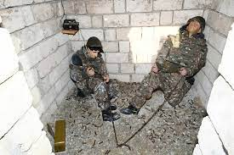
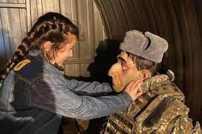
III. Persecution against Armenians 8/11
Armenia v. Azerbaijan (First provisional measure - Hate Speech)
Fallen soldiers‘ helmets
Trophy Park in Baku
Numerous war crimes against Armenians
During 2020 war
Describing Armenians with big noses
Used terminologies by the President of Azerbaijan to describe Armenians
“Barbarians”, “dogs”, “despised and savage enemy”, “having no moral values”, “virus more dangerous than the coronavirus”

Slide 20
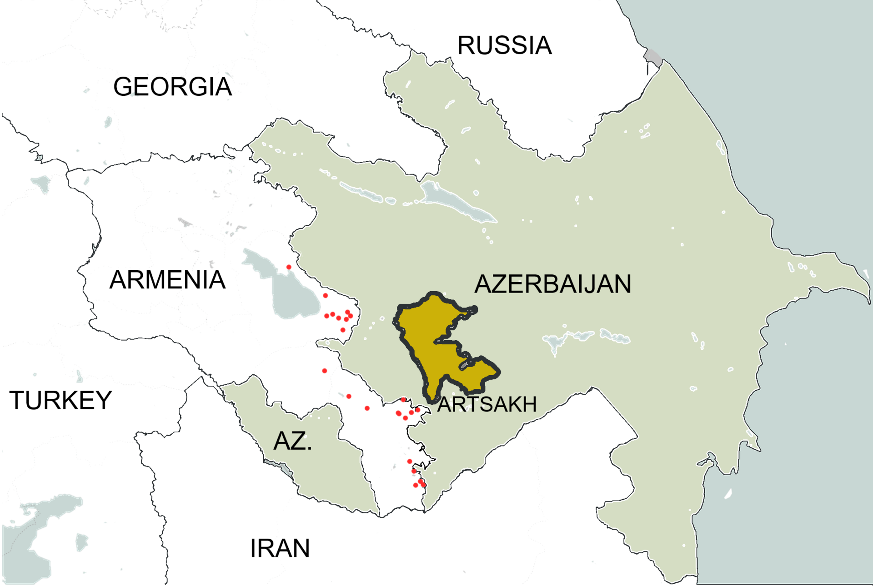
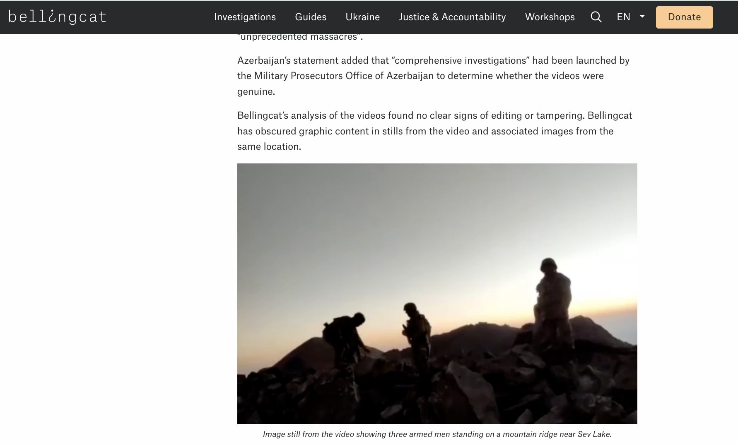
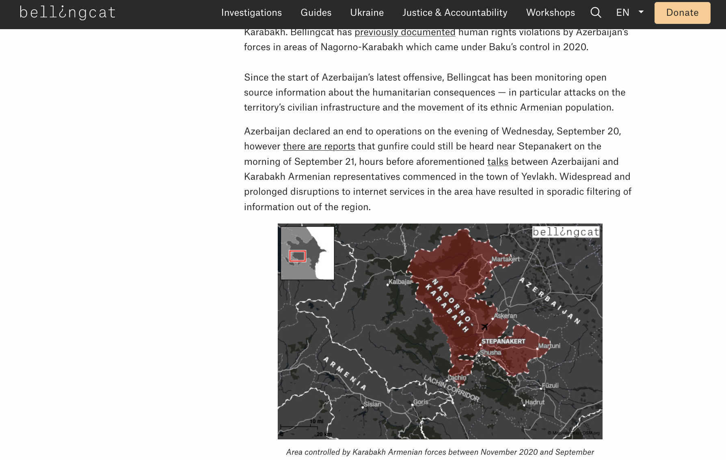
III. Persecution against Armenians 9/11
Clashes since 2021
May 2021 Escalation on the Armenian-Azerbaijani border
September 2022: Azerbaijani aggression on Armenian territory with occupation
December 2022: Azerbaijani blockade of the Lachin corridor
September 2023 Azerbaijani so-called “anti-terror measures”: Aggression against Nagorno-Karabakh
September-October 2023 deportation of 100,000 Armenians from Nagorno-Karabakh
Accompanied by numerous war crimes

Slide 21
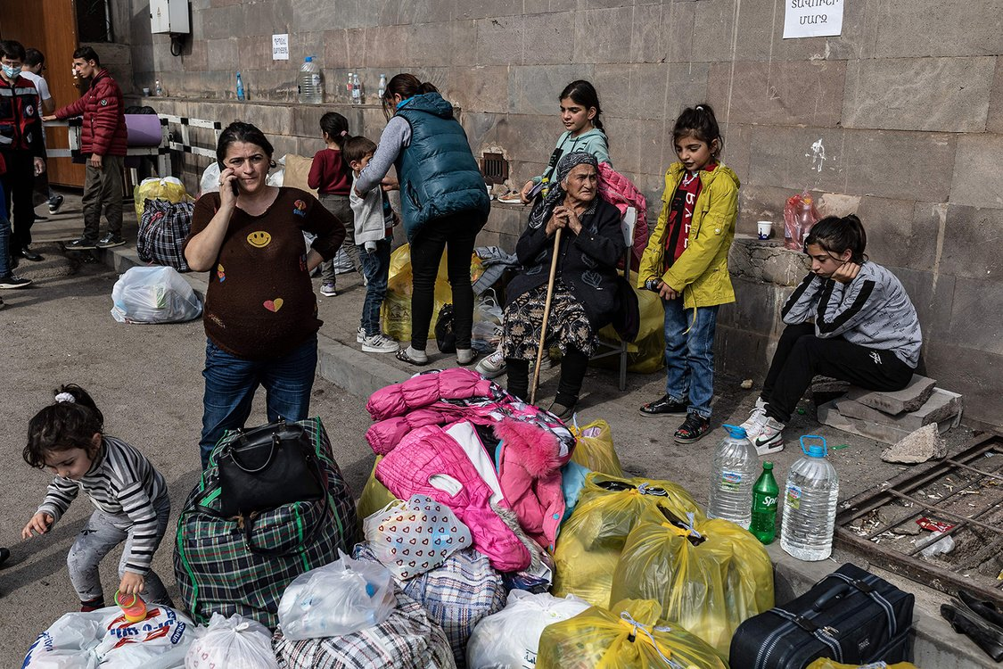
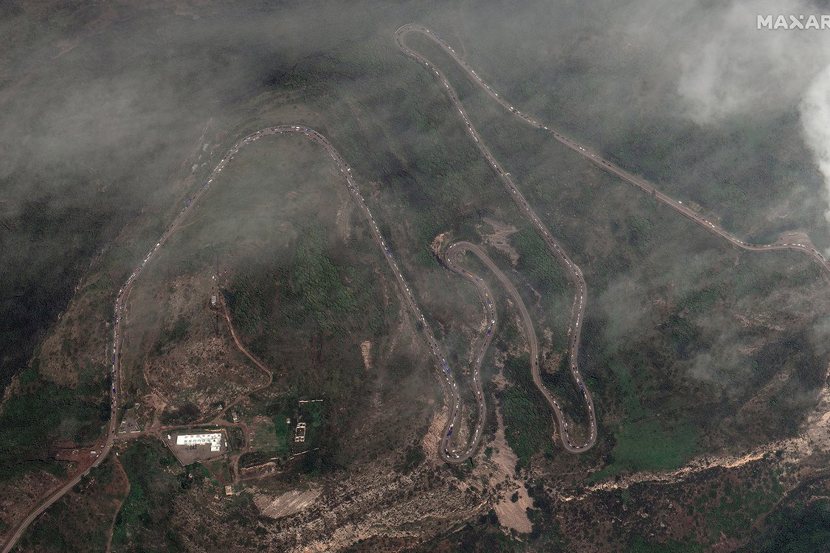
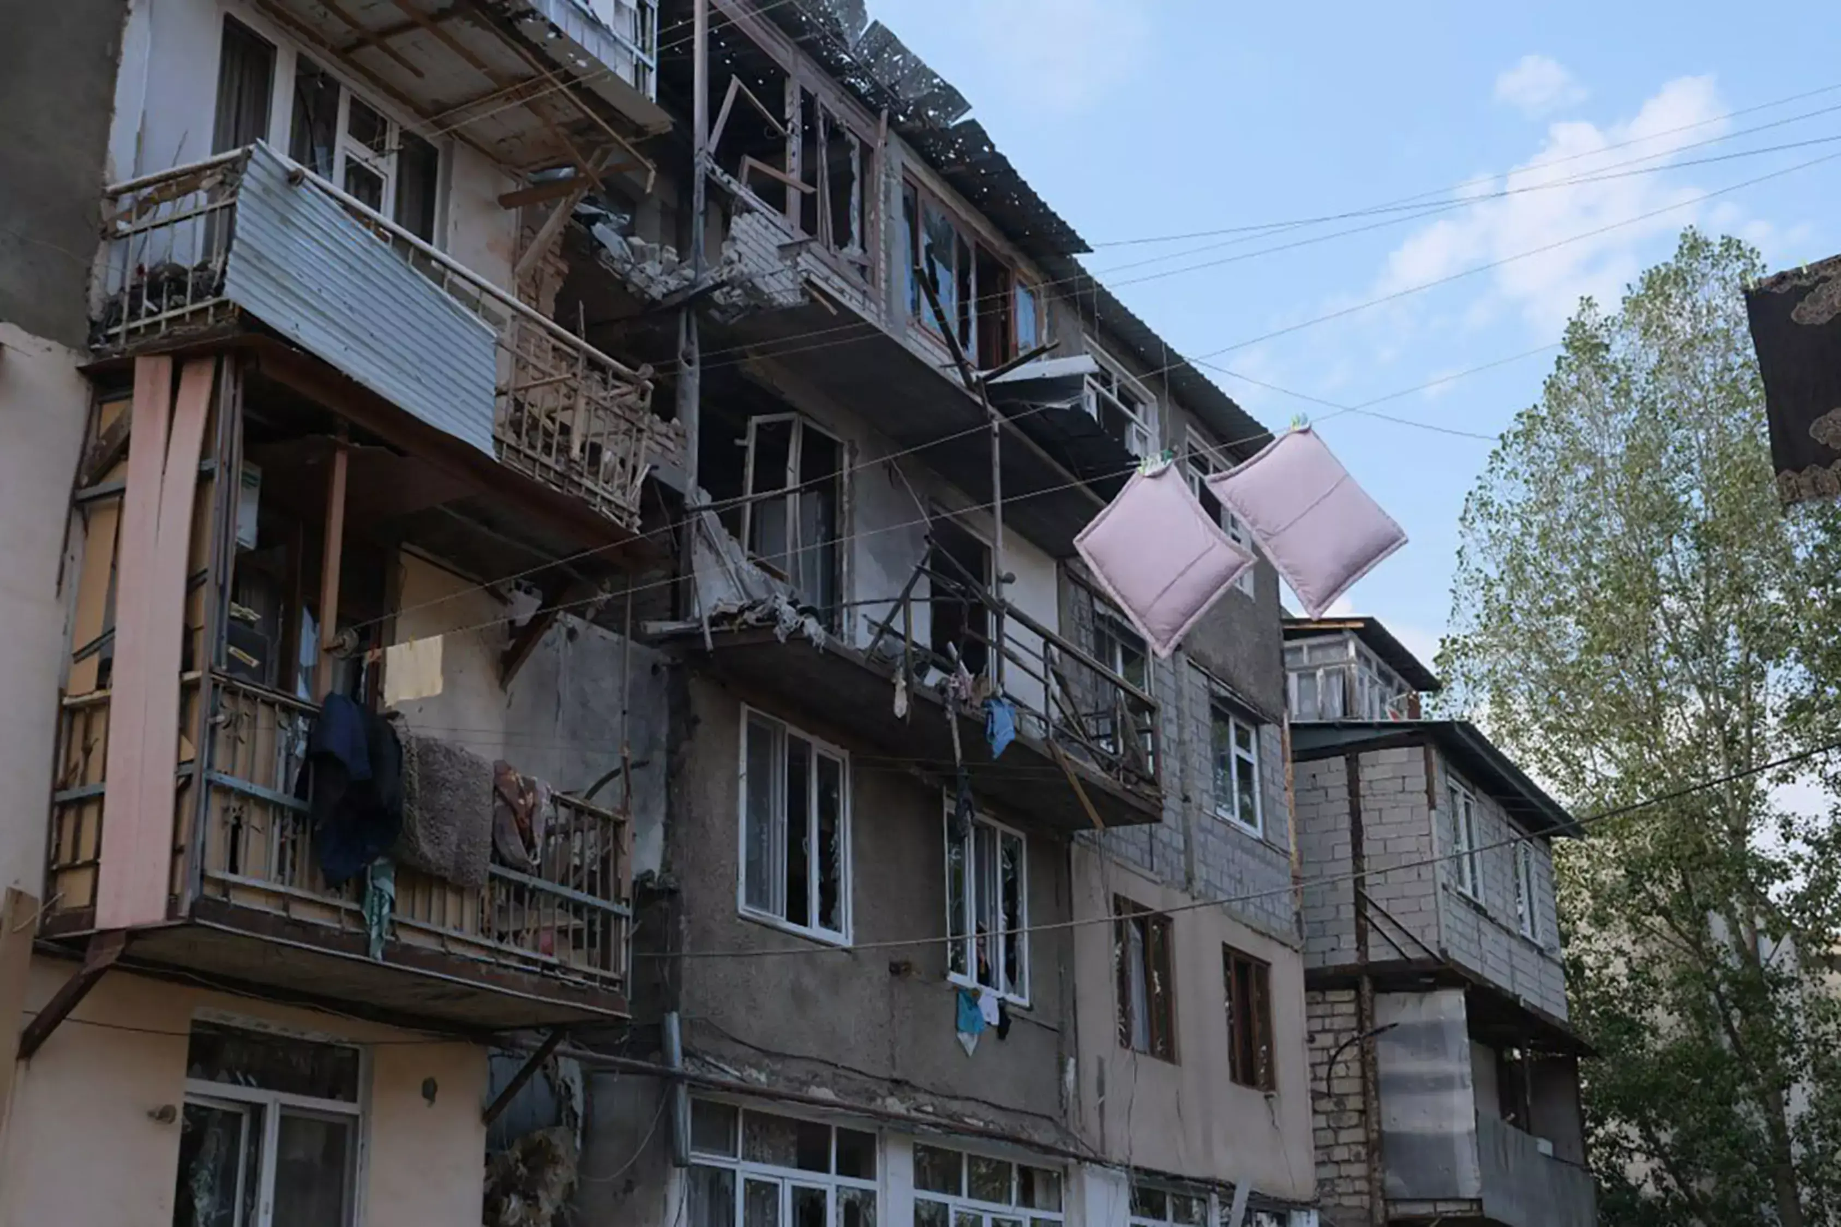
III. Persecution against Armenians 10/11
Armenians fleeing Nagorno-Karabakh

Slide 22
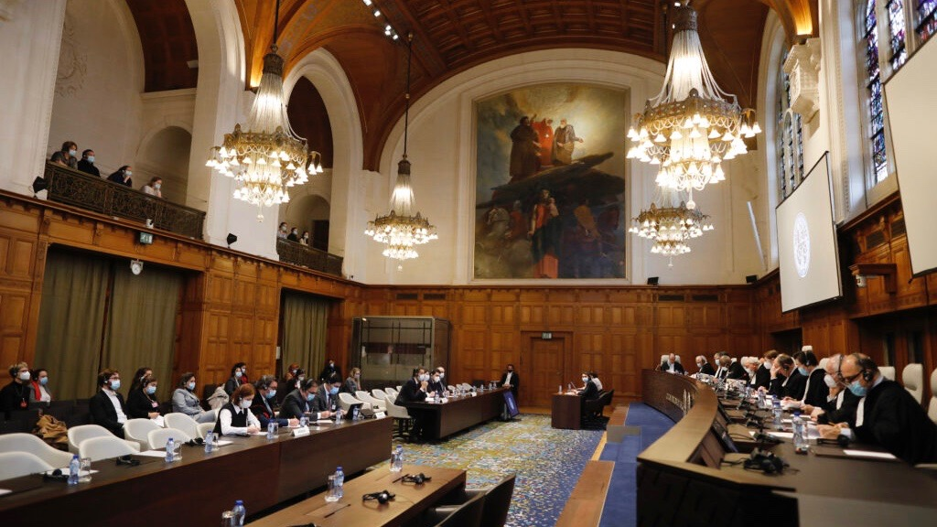
III. Persecution against Armenians 11/11
Proceedings based on ICERD
Armenia v. Azerbaijan
Proceedings based on International Convention on the Elimination of All Forms of Racial Discrimination (ICERD)

Slide 23
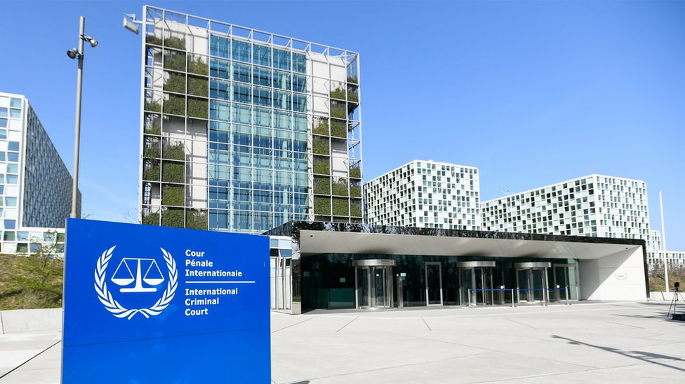
IV. Possible Proceedings before the ICC
Trigger Mechanism and Admissibility
State Referral
UN SC Referral
Prosecutor (proprio motu)
Complementarity
Gravity
Interests of Justice

Slide 24
V. Concluding remarks
The Azerbaijani authorities must be held accountable by the International Criminal Court for the persecution of Armenians. The evidence clearly supports this claim. Failure by the international community to address impunity for such crimes cannot be overlooked, as it increases the risk of recurrence.

Slide 25
Thank you very much for your attention

